Slide 1




Slide 2
CANNES YOUNG LIONS
COMPETITIONS 2018

Slide 3

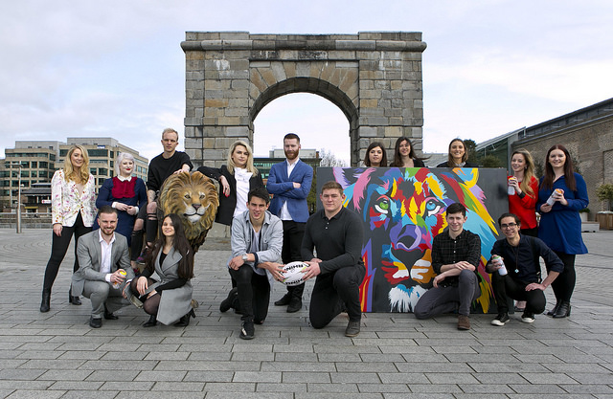
TEAM IRELAND IN 2017

Slide 4
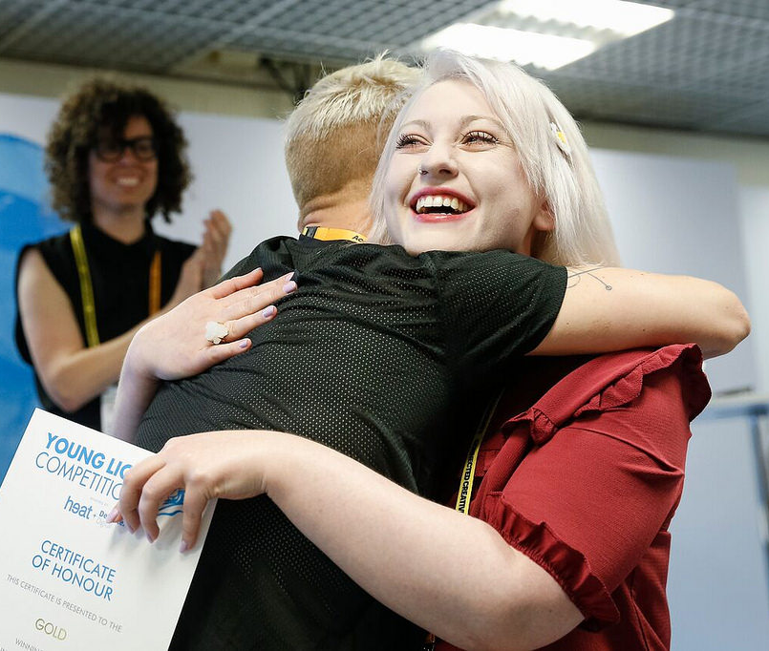
Young Lions –
Winning Gold
Emma Wilson and Kyle Schouw, designers from RichardsDee Agency took their place on the global stage as they were awarded a gold medal for Team Ireland in the Design category.
This is the first time Ireland has ever taken home gold in the Young Lions Competition in its’ 23 year history.

Slide 5


Young Lions 2018
IRELAND WILL COMPETE IN 6 CATEGORIES
MEDIA
PR
YOUNG MARKETERS
DIGITAL
FILM
PRINT
12 IRISH YOUNG LIONS COMPETING AT CANNES….

Slide 6

Young Lions Competition in Numbers 2017
DIGITAL
DESIGN
FILM
PRINT
18
8
30
7
MEDIA
PR
YOUNG MARKETERS
23
16
19

Slide 7
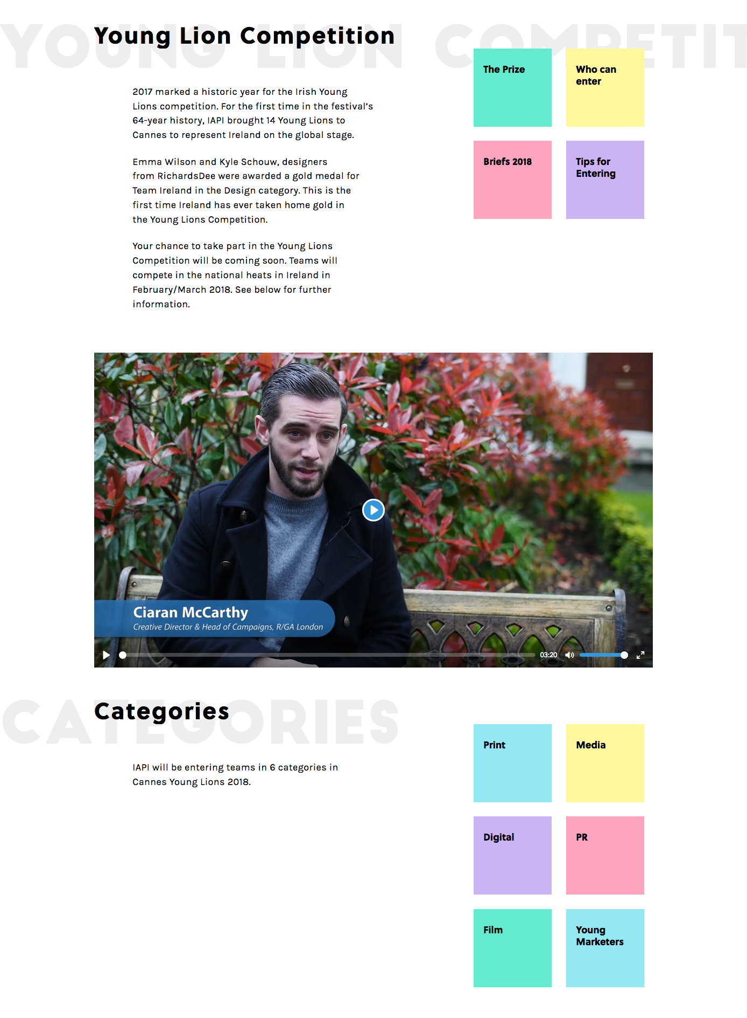
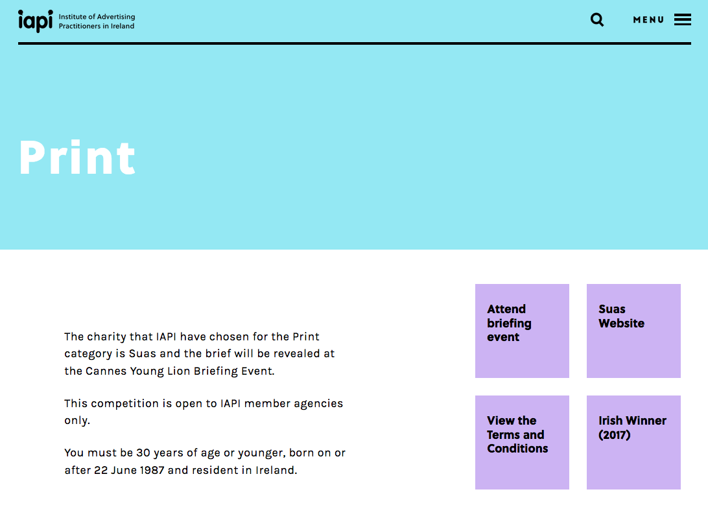
ALL YOU NEED TO KNOW
All information is on the website
www.iapi.ie/awards/cannes-lions

Slide 8
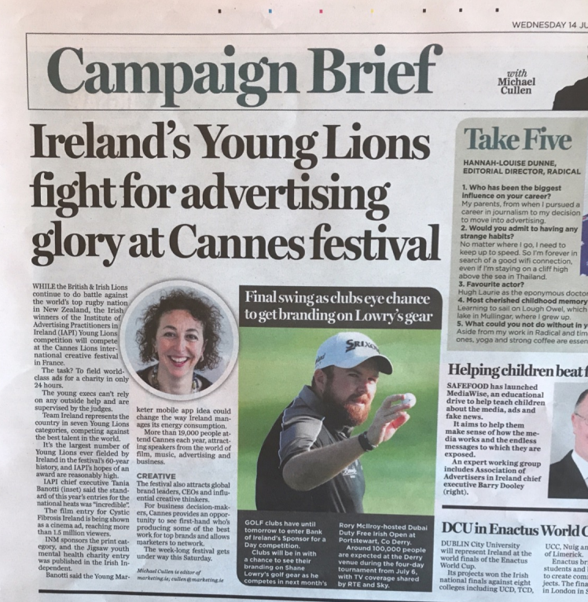
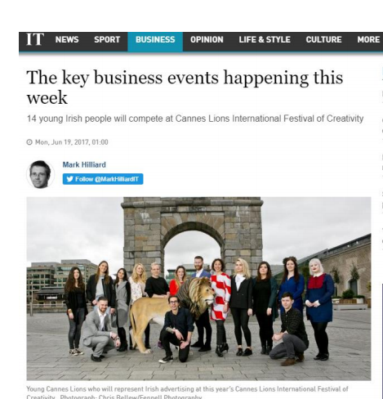
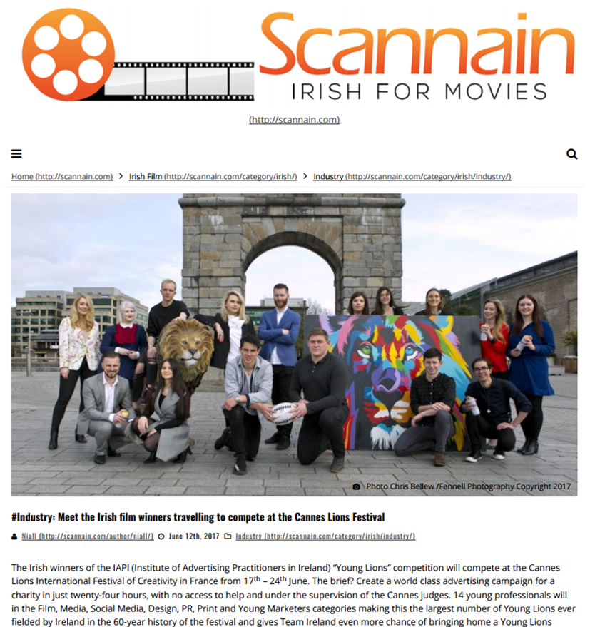
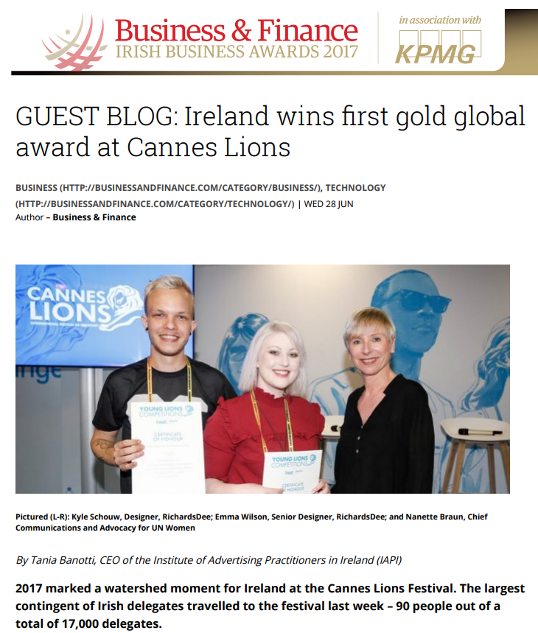
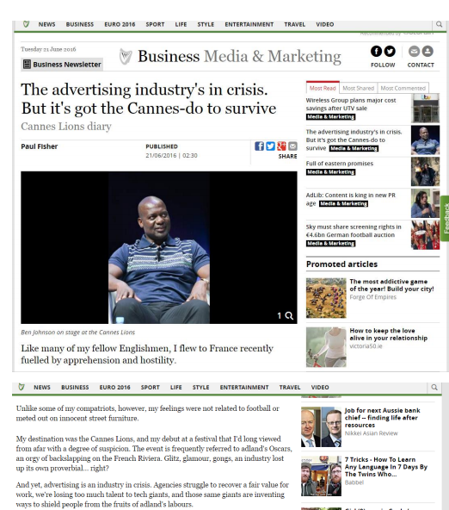
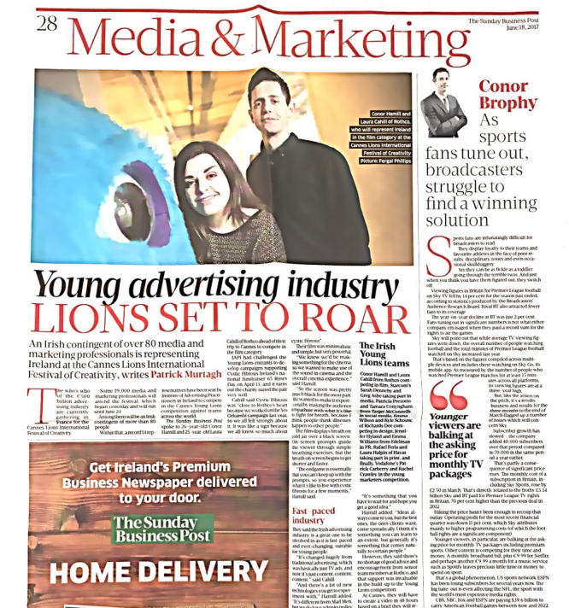
We will hero you!
.

Slide 9
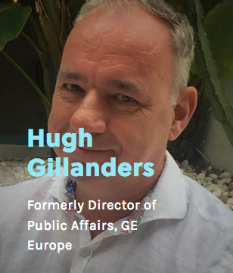
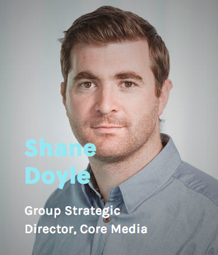
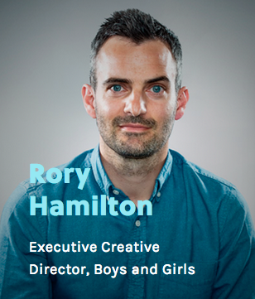
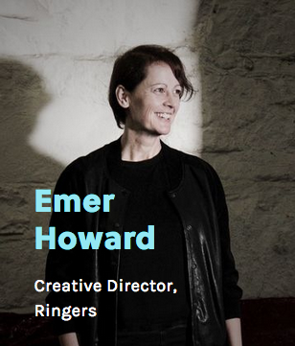

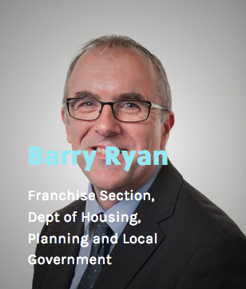
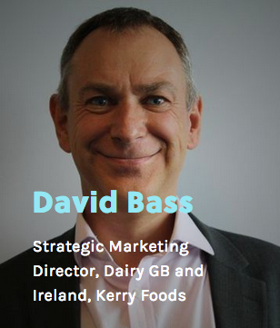
Young Lions - Young Marketers Jury
Sponsor

Slide 10
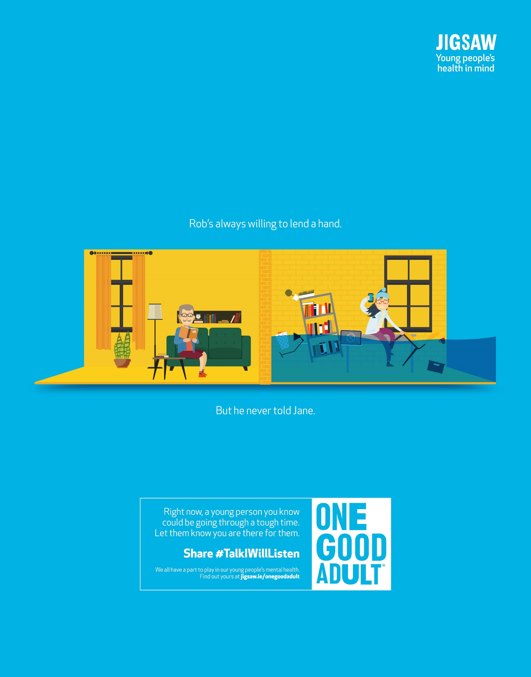
Print Young Lions
We believe in activating the Young Lions competitions where possible as this brings the work to a larger audience.
The winners of the 2018 Print Young Lions will have their work printed in 2 national newspapers for six weeks.
Winning YL Print Entry for Jigsaw (Youth Mental Health Charity)

Slide 11
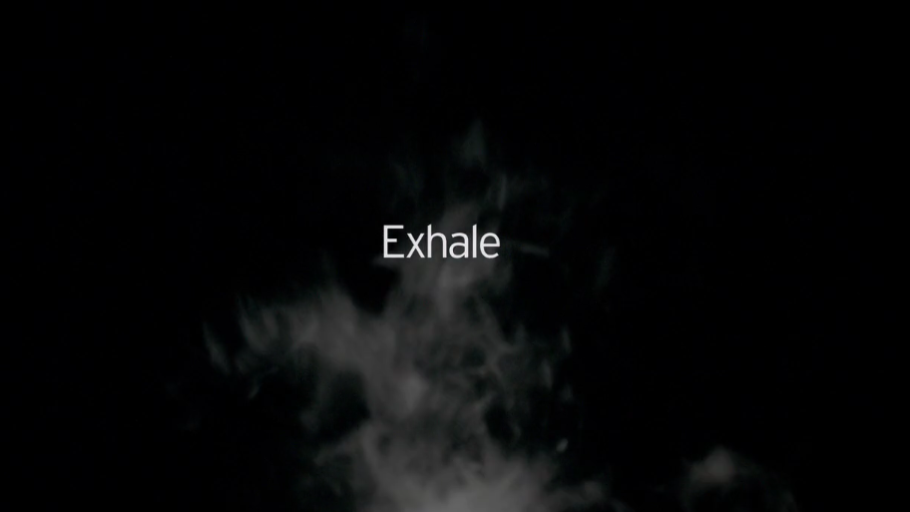
Film Young Lions
"From winning the national competition and representing Ireland at Cannes, to experiencing the whole process of bringing such a simple idea to light, the Young Lions Film competition has been an unforgettable experience. We're really proud of the final result and hope that our ad will positively impact Cystic Fibrosis Ireland."
- Laura Cahill and Conor Hamill
https://vimeo.com/236423058

Slide 12
s
Jury Presentation Schedule for shortlisted teams
Monday 5 March closing date for entries
Tuesday 20 March – Media Teams
Wednesday 21 March – Film Teams
Thursday 22 March – PR Teams
Friday 23 March - Young Marketers
Notes:
As the most prestigious international annual advertising and communications awards, over 35,500 entries from all over the world are showcased and judged at the Festival. Winning companies receive the highly coveted Lion trophy, a global benchmark of creative excellence, for Film, Print, Outdoor, Interactive, Radio, Design, Product Design, Promo & Activation, Film Craft, Mobile, Branded Entertainment and Integrated advertising, as well as the best Media, Direct, PR, Titanium, Creative Effectiveness, Creative Data and Innovation ideas. The Festival is also the only truly global meeting place for advertisers, advertising and communication professionals.

Slide 13

FAQs
Can I enter multiple times in the same category?
No. One entry per team. Brands can enter multiple teams.
Can I work with people outside my company?
Not for this competition as you have to use your company/brand assets.
If I entered last year can I try again?
Yes, so long as you are under 30

